Slide 1




CS4.301 Data & Applications
Ponnurangam Kumaraguru (“PK”)
#ProfGiri @ IIIT Hyderabad
pk.profgiri
/in/ponguru
@ponguru
Ponnurangam.kumaraguru

Slide 2
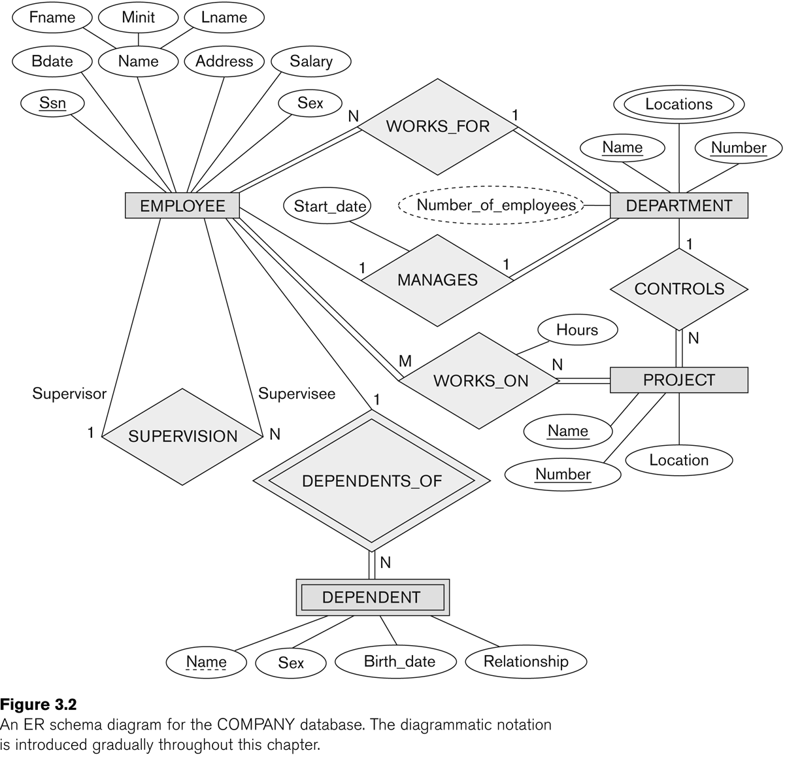
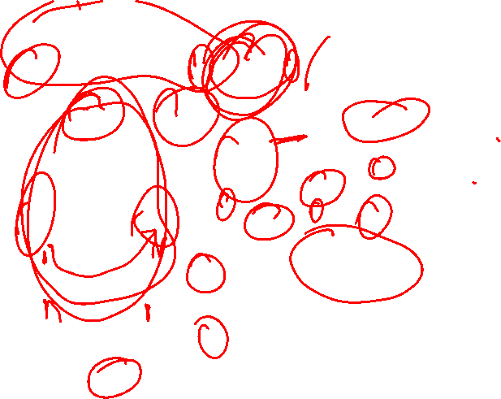
ER DIAGRAM – Relationship Types are: WORKS_FOR, MANAGES, WORKS_ON, CONTROLS, SUPERVISION, DEPENDENTS_OF

Slide 3
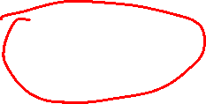
Recursive Relationship Type is: SUPERVISION (participation role names are shown)

Slide 4
Weak Entity Types
An entity that does not have a key attribute and that is identification-dependent on another entity type.
A weak entity must participate in an identifying relationship type with an owner or identifying entity type
Entities are identified by the combination of:
A partial key of the weak entity type
The particular entity they are related to in the identifying relationship type
Example:
A DEPENDENT entity is identified by the dependent’s first name, and the specific EMPLOYEE with whom the dependent is related
Name of DEPENDENT is the partial key
DEPENDENT is a weak entity type
EMPLOYEE is its identifying entity type via the identifying relationship type DEPENDENT_OF

Slide 5
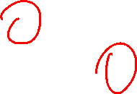
Example Attribute of a Relationship Type: Hours of WORKS_ON

Slide 6
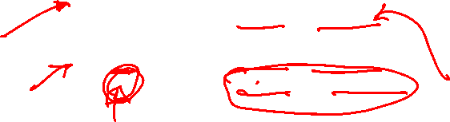
Alternative (min, max) notation for relationship structural constraints:
Specified on each participation of an entity type E in a relationship type R
Specifies that each entity e in E participates in at least min and at most max relationship instances in R
Default(no constraint): min=0, max=n (signifying no limit)
Must have min≤max, min≥0, max ≥1
Derived from the knowledge of mini-world constraints
Cardinality & Participation taken together called structural constraints; (m,n); m = 0 is partial, m = 1 total
Examples:
A department has exactly one manager and an employee can manage at most one department.
Specify (0,1) for participation of EMPLOYEE in MANAGES
Specify (1,1) for participation of DEPARTMENT in MANAGES
An employee can work for exactly one department but a department can have any number of employees.
Specify (1,1) for participation of EMPLOYEE in WORKS_FOR
Specify (0,n) for participation of DEPARTMENT in WORKS_FOR

Slide 7
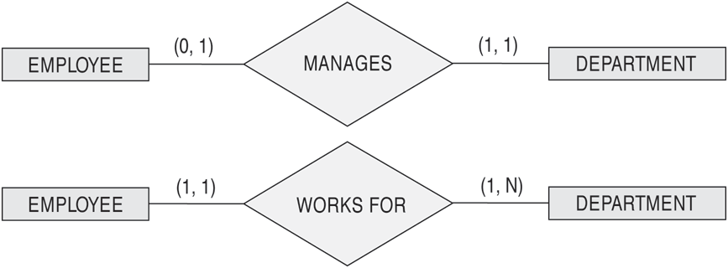
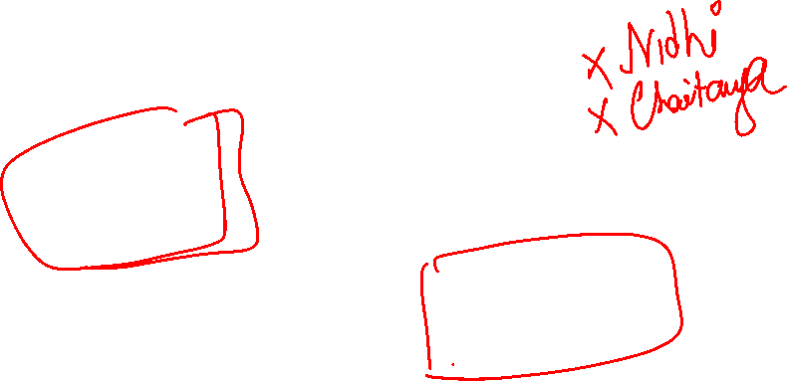
The (min,max) notation for relationship constraints
Read the min,max numbers next to the entity type and looking away from the entity type

Slide 8
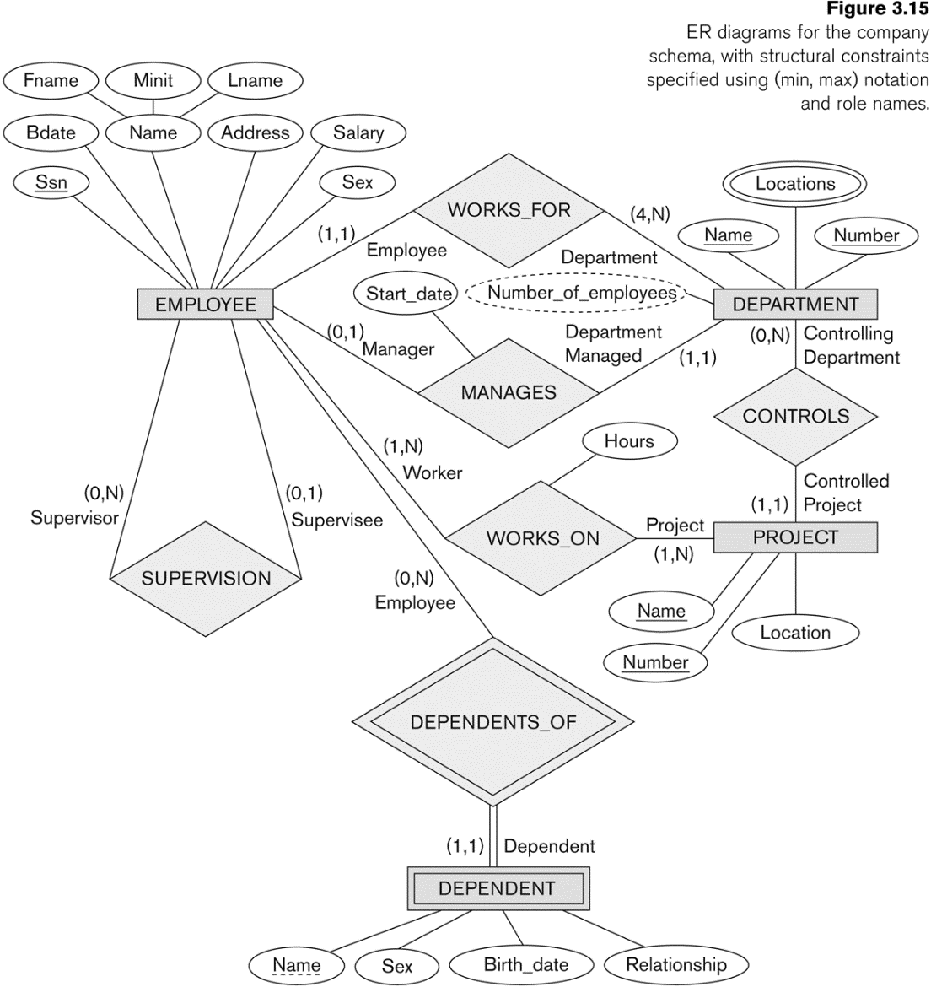

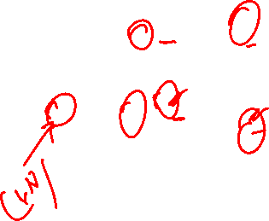
COMPANY ER Schema Diagram using (min, max) notation

Slide 9
Alternative diagrammatic notation
ER diagrams is one popular example for displaying database schemas
Many other notations exist in the literature and in various database design and modeling tools
UML class diagrams is representative of another way of displaying ER concepts that is used in several commercial design tools

Slide 10
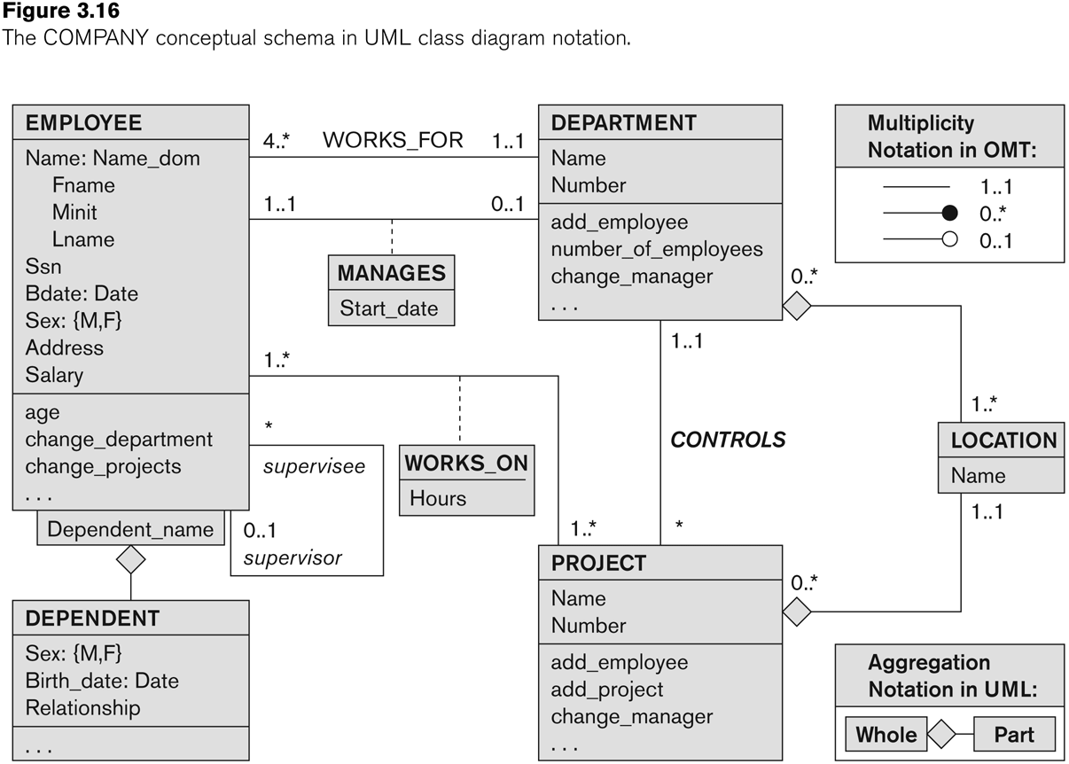
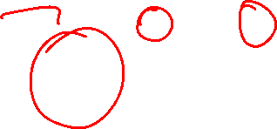
UML class diagram for COMPANY database schema

Slide 11
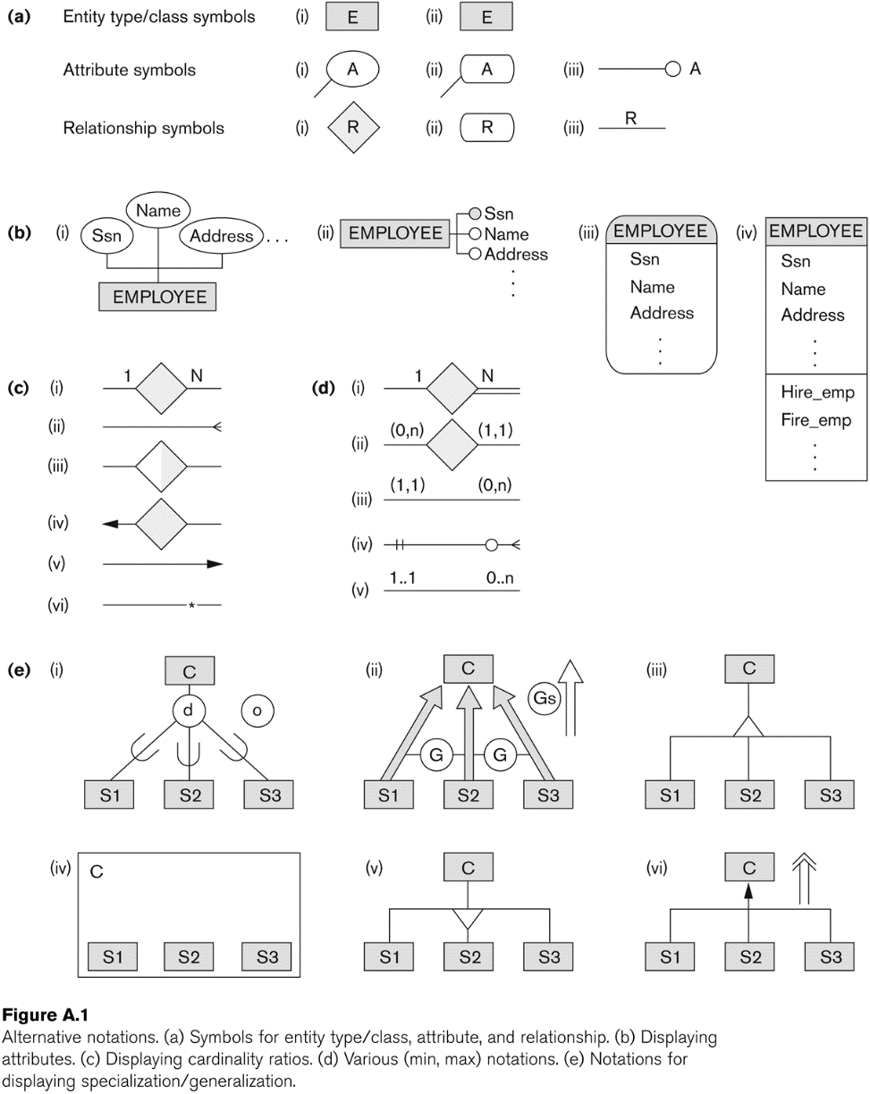
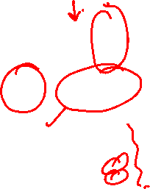
Other alternative diagrammatic notations

Slide 12
Some of the Automated Database Design Tools (Note: Not all may be on the market now)
COMPANY | TOOL | FUNCTIONALITY
Embarcadero Technologies | ER Studio | Database Modeling in ER and IDEF1X
 | DB Artisan | Database administration, space and security management
Oracle | Developer 2000/Designer 2000 | Database modeling, application development
Popkin Software | System Architect 2001 | Data modeling, object modeling, process modeling, structured analysis/design
Platinum (Computer Associates) | Enterprise Modeling Suite: Erwin, BPWin, Paradigm Plus | Data, process, and business component modeling
Persistence Inc. | Pwertier | Mapping from O-O to relational model
Rational (IBM) | Rational Rose | UML Modeling & application generation in C++/JAVA
Resolution Ltd. | Xcase | Conceptual modeling up to code maintenance
Sybase | Enterprise Application Suite | Data modeling, business logic modeling
Visio | Visio Enterprise | Data modeling, design/reengineering Visual Basic/C++

Slide 13
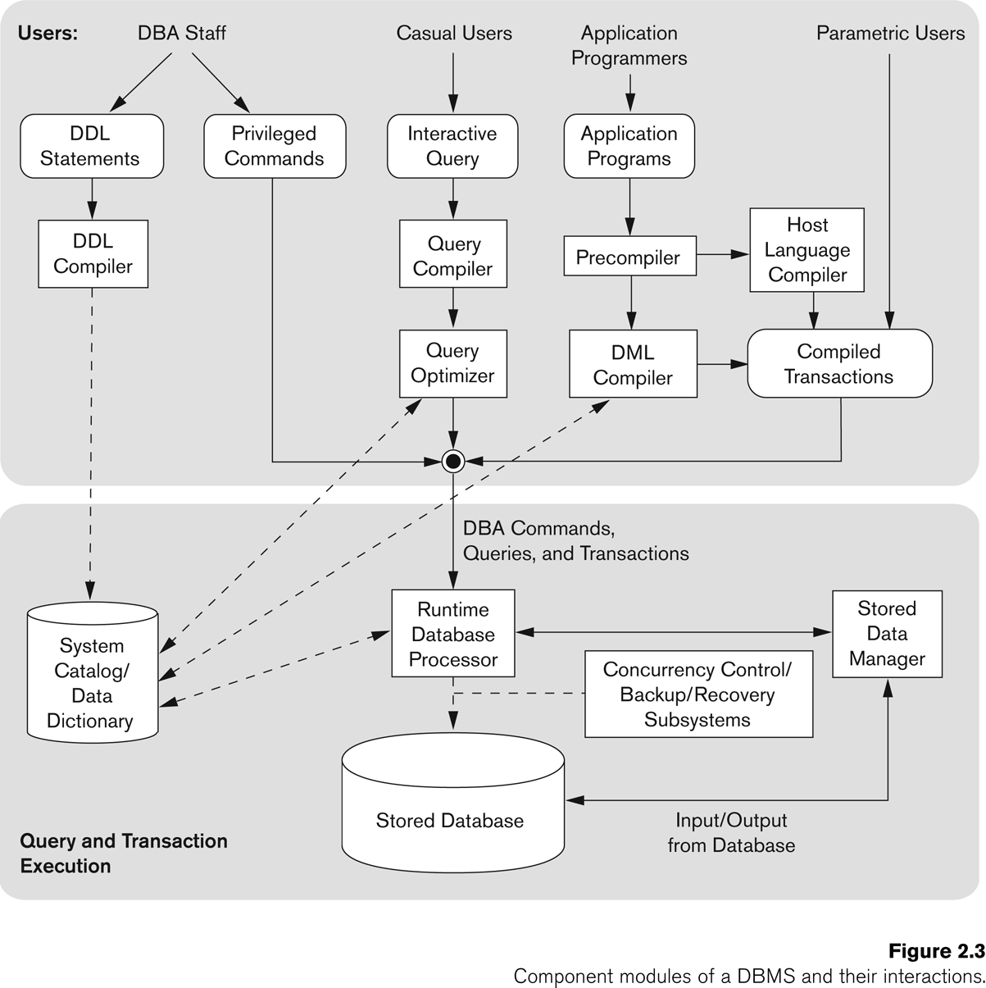
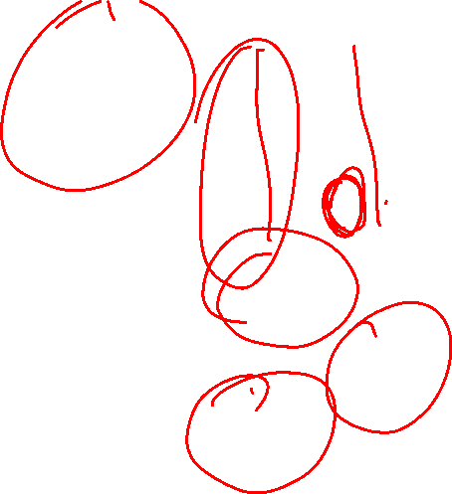
Typical DBMS Component Modules

Slide 14
Centralized and Client-Server DBMS Architectures
Centralized DBMS:
Combines everything into single system including- DBMS software, hardware, application programs, and user interface processing software.
User can still connect through a remote terminal – however, all processing is done at centralized site.

Slide 15
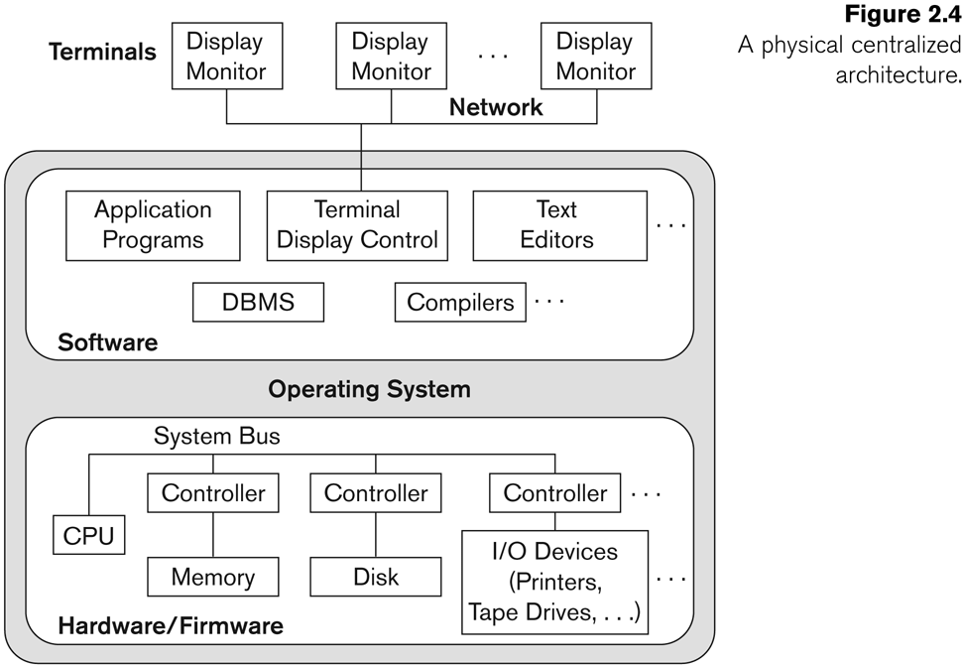

A Physical Centralized Architecture

Slide 16
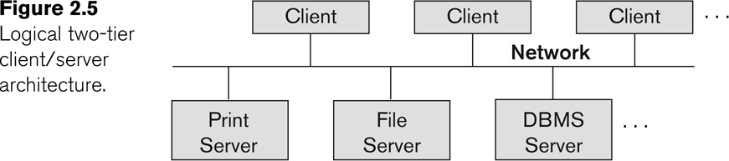
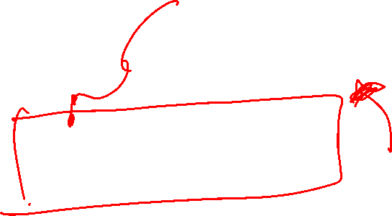
Logical two-tier client server architecture

Slide 17
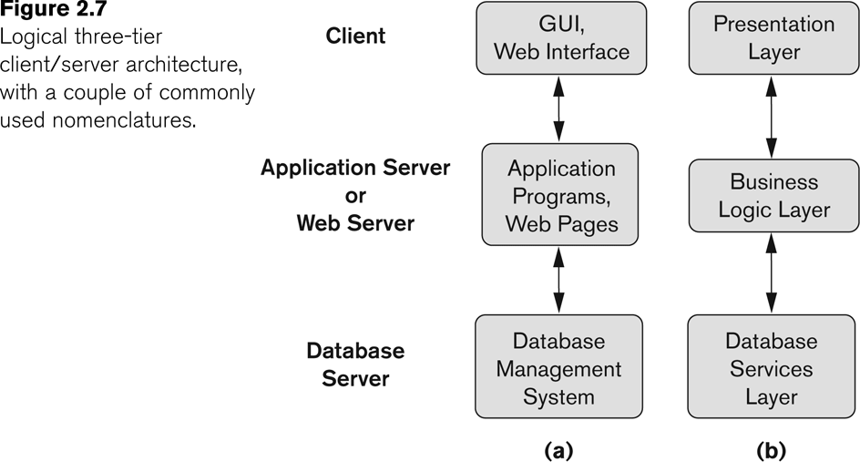
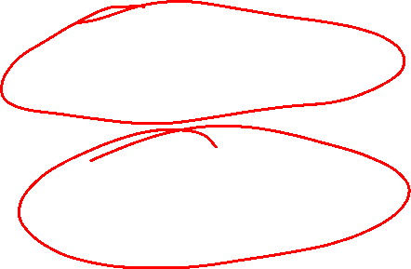
Three-tier client-server architecture

Slide 18
The Relational Data Model and Relational Database Constraints

Slide 19
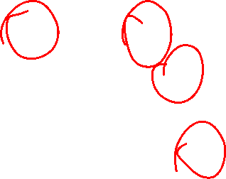
Informal Definitions
Informally, a relation looks like a table of values.
A relation typically contains a set of rows.
The data elements in each row represent certain facts that correspond to a real-world entity or relationship
In the formal model, rows are called tuples
Each column has a column header that gives an indication of the meaning of the data items in that column
In the formal model, the column header is called an attribute name (or just attribute)

Slide 20
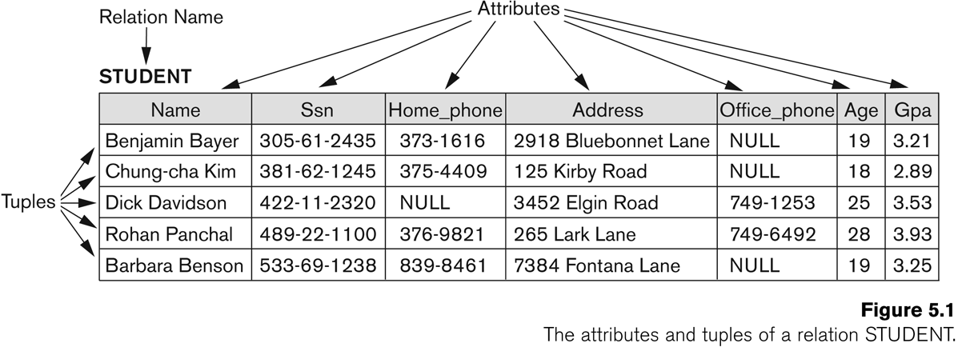

Example of a Relation
Notes:
"Entity" is a real world concept, such as "a person" in your example. "Relation" is a set of tuples (records), each representing a model of an entity.
"Entity" is a real world concept, such as "a person" in your example. "Relation" is a set of tuples (records), each representing a model of an entity.

Slide 21
Informal Definitions
Key of a Relation:
Each row has a value of a data item (or set of items) that uniquely identifies that row in the table
Called the key
In the STUDENT table, SSN is the key
Sometimes row-ids or sequential numbers are assigned as keys to identify the rows in a table
Called artificial key or surrogate key

Slide 22
This lecture

Slide 23

Formal Definitions - Schema
The Schema (or description) of a Relation:
Denoted by R(A1, A2, .....An)
R is the name of the relation
The attributes of the relation are A1, A2, ..., An
Example:
CUSTOMER (Cust-id, Cust-name, Address, Phone#)
CUSTOMER is the relation name
Defined over the four attributes: Cust-id, Cust-name, Address, Phone#
Each attribute has a domain or a set of valid values.
For example, the domain of Cust-id is 6 digit numbers.

Slide 24
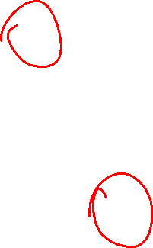
Formal Definitions - Tuple
A tuple is an ordered set of values (enclosed in angled brackets ‘< … >’)
Each value is derived from an appropriate domain.
A row in the CUSTOMER relation is a 4-tuple and would consist of four values, for example:
<632895, "John Smith", "101 Main St. Atlanta, GA 30332", "(404) 894-2000">
This is called a 4-tuple as it has 4 values
A tuple (row) in the CUSTOMER relation.
A relation is a set of such tuples (rows)

Slide 25

Formal Definitions - Domain
A domain has a logical definition:
Example: “USA_phone_numbers” are the set of 10 digit phone numbers valid in the U.S.
A domain also has a data-type or a format defined for it.
The USA_phone_numbers may have a format: (ddd)ddd-dddd where each d is a decimal digit.
Dates have various formats such as year, month, date formatted as yyyy-mm-dd, or as dd mm,yyyy etc.
The attribute name designates the role played by a domain in a relation:
Used to interpret the meaning of the data elements corresponding to that attribute
Example: The domain Date may be used to define two attributes named “Invoice-date” and “Payment-date” with different meanings

Slide 26
Formal Definitions - State
The relation state is a subset of the Cartesian product of the domains of its attributes
each domain contains the set of all possible values the attribute can take.
Example: attribute Cust-name is defined over the domain of character strings of maximum length 25
dom(Cust-name) is varchar(25)
The role these strings play in the CUSTOMER relation is that of the name of a customer.

Slide 27
Formal Definitions - Summary
Formally,
Given R(A1, A2, .........., An)
r(R) ⊂ dom (A1) X dom (A2) X ....X dom(An)
R(A1, A2, …, An) is the schema of the relation
R is the name of the relation
A1, A2, …, An are the attributes of the relation
r(R): a specific state (or "value" or “population”) of relation R – this is a set of tuples (rows)
r(R) = {t1, t2, …, tn} where each ti is an n-tuple [All Rows in a table]
ti = <v1, v2, …, vn> where each vj element-of dom(Aj) [Single Row in the table]

Slide 28

Formal Definitions - Example
Let R(A1, A2) be a relation schema:
Let dom(A1) = {0,1}
Let dom(A2) = {a,b,c}
Then: dom(A1) X dom(A2) is all possible combinations:
{<0,a> , <0,b> , <0,c>, <1,a>, <1,b>, <1,c> }
The relation state r(R) ⊂ dom(A1) X dom(A2)
For example: r(R) could be {<0,a> , <0,b> , <1,c> }
this is one possible state (or “population” or “extension”) r of the relation R, defined over A1 and A2.
It has three 2-tuples: <0,a> , <0,b> , <1,c>

Slide 29
Definition Summary
Informal Terms |  | Formal Terms
Table |  | Relation
Column Header |  | Attribute
All possible Column Values |  | Domain
Row |  | Tuple
Table Definition |  | Schema of a Relation
Populated Table |  | State of the Relation

Slide 30
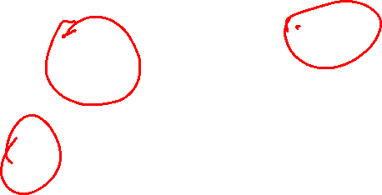
Example – A relation STUDENT

Slide 31
Characteristics Of Relations
Ordering of tuples in a relation r(R):
The tuples are not considered to be ordered, even though they appear to be in the tabular form.
Ordering of attributes in a relation schema R (and of values within each tuple):
We will consider the attributes in R(A1, A2, ..., An) and the values in t=<v1, v2, ..., vn> to be ordered .
(However, a more general alternative definition of relation does not require this ordering. It includes both the name and the value for each of the attributes ).
Example: t= { <name, “John” >, <SSN, 123456789> }
This representation may be called as “self-describing”.

Slide 32
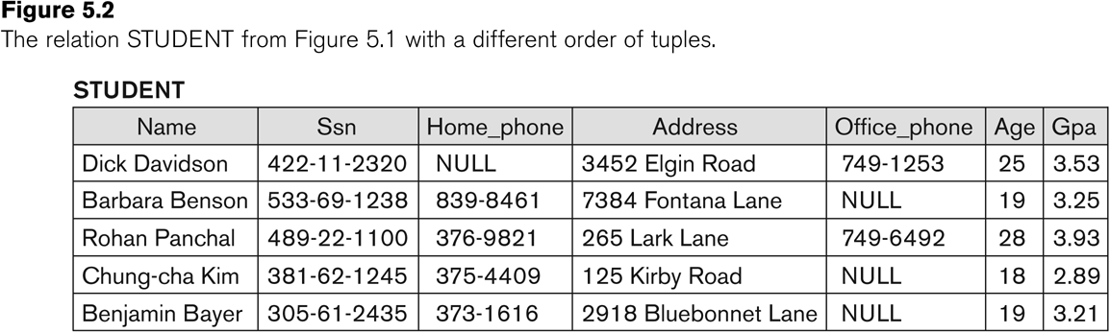
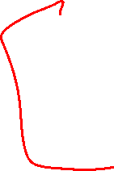
Same state as previous Figure (but with different order of tuples)

Slide 33

Characteristics Of Relations
Values in a tuple:
All values are considered atomic (indivisible).
Each value in a tuple must be from the domain of the attribute for that column
If tuple t = <v1, v2, …, vn> is a tuple (row) in the relation state r of R(A1, A2, …, An)
Then each vi must be a value from dom(Ai)
A special null value is used to represent values that are unknown or not available or inapplicable in certain tuples.

Slide 34
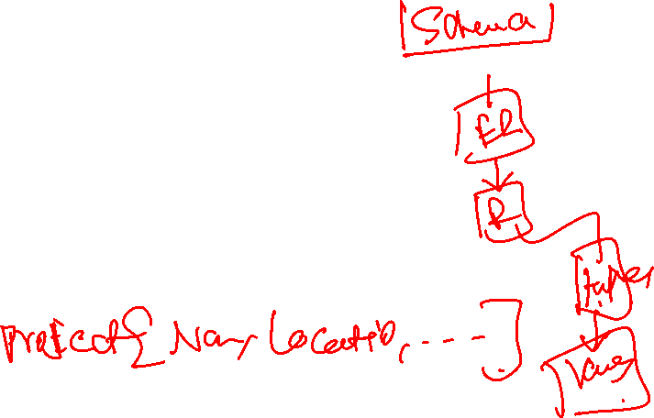
Characteristics Of Relations
Notation:
We refer to component values of a tuple t by:
t[Ai] or t.Ai
This is the value vi of attribute Ai for tuple t
Similarly, t[Au, Av, ..., Aw] refers to the subtuple of t containing the values of attributes Au, Av, ..., Aw, respectively in t

Slide 35
CONSTRAINTS
Constraints determine which values are permissible and which are not in the database.
They are of three main types:
1. Inherent or Implicit Constraints: These are based on the data model itself. (E.g., relational model does not tuples to be duplicates)
2. Schema-based or Explicit Constraints: They are expressed in the schema by using the facilities provided by the model. (E.g., max. cardinality ratio constraint in the ER model)
3. Application based or semantic constraints: These are beyond the expressive power of the model and must be specified and enforced by the application programs.

Slide 36
Relational Integrity Constraints
Constraints are conditions that must hold on all valid relation states.
There are three main types of (explicit schema-based) constraints that can be expressed in the relational model:
Key constraints
Entity integrity constraints
Referential integrity constraints
Another schema-based constraint is the domain constraint
Every value in a tuple must be from the domain of its attribute (or it could be null, if allowed for that attribute)

Slide 37
Key Constraints
Superkey of R:
Super Key is an attribute (or set of attributes) that is used to uniquely identifies all attributes in a relation.
Is a set of attributes SK of R with the following condition:
No two tuples in any valid relation state r(R) will have the same value for SK
That is, for any distinct tuples t1 and t2 in r(R), t1[SK] ≠ t2[SK]
This condition must hold in any valid state r(R)
Key of R:
A "minimal" superkey
A candidate key (or key) is a set of attributes (or attributes) that uniquely identify the tuples in relation to or table.

Slide 38
Key Constraints (continued)
Example: Student{ID, First_name, Last_name, Age, Sex, Phone_no}
Two candidate keys: ID & {First_name, Last_name, Age, Sex, Phone_no}
Consider the STUDENT relation schema:
Attribute Ssn is a key, because no 2 students tuples can have the same Ssn
Any set of attributes that include Ssn, like {Ssn, Name, Age} is a superkey it uniquely identifies all attributes in a relation
In general:
Any key is a superkey (but not vice versa)
Any set of attributes that includes a key is a superkey
A minimal superkey is also a key

Slide 39
Bibliography / Acknowledgements
Instructor materials from Elmasri & Navathe 7e

Slide 40





pk.profgiri
Ponnurangam.kumaraguru
/in/ponguru
ponguru
Thank you
for attending the class!!!
pk.guru@iiit.ac.in

